Slide 1
Social Media Usage and Adolescent Health
S. Craig Watkins, PhD
University of Texas at Austin
Rohan Mehta,
University of Texas at Austin

Slide 2
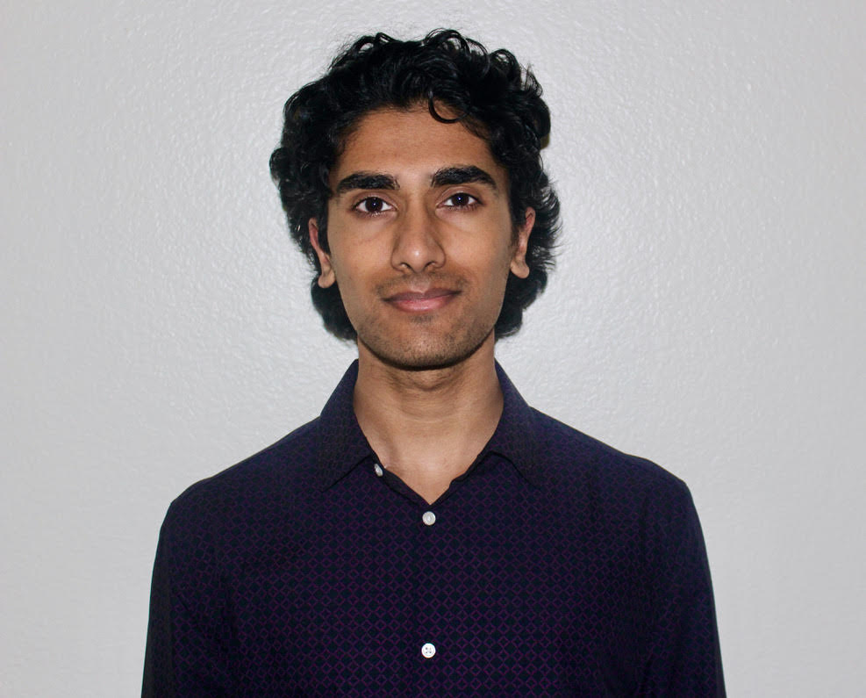
Introductions
Rohan is a 3rd year Biomedical Engineering major at UT Austin. Upon graduation, he plans to attend medical school. Rohan is interested in holistic and preventative medicine, combatting lifestyle disease, mental health, exercise science, and plant-based nutrition. Rohan volunteers at PCC with the outreach committee within the Youth Advisory Council, and also works as a media and video editing volunteer lead with People's Kids from Home.
Notes:
ROHAN LEAD

Slide 4
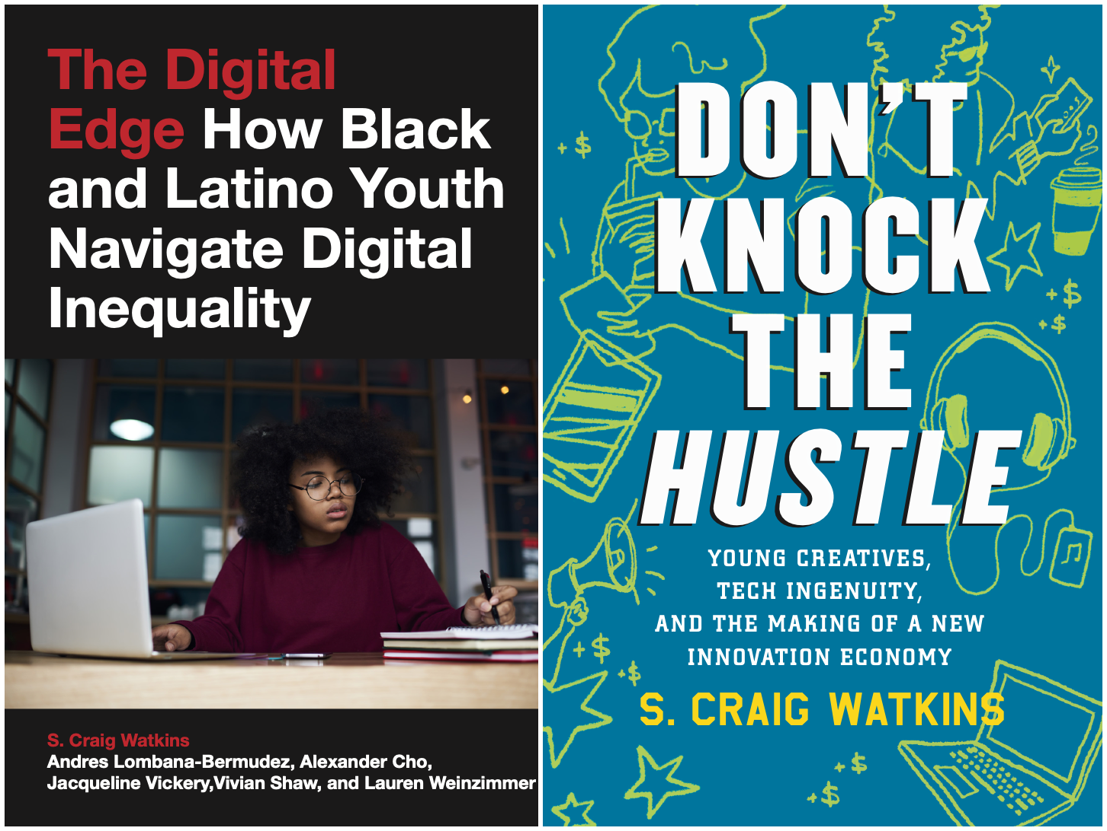
Craig will add images from book covers

Slide 5
Youth Perspectives on Social Media
Notes:
ROHAN LEAD These are perspectives share by other youth advisory council members. I feel that youth are often aware of social media having negative effects, this is what they have to say about it.

Slide 6
How would you like adults to discuss social media use?
“...coming across as good-intentioned and not condescending or out-of-touch with what adolescents want…”
“...acknowledging the downsides as well as the positives of social media…”
“...a very holistic and balanced view that operates as a two-sided conversation.”
Notes:
ROHAN LEAD

Slide 7
What is your perspective on social media?
“I do believe that social media does affect moods, it can be seen how it can create division in families [due to] different information being shared on different platforms each with their own generation demographic.”
“...the effect on the internet on mental health isn't super well understood but is definitely very impactful… youth can certainly notice the effect social media has on themselves, so it’s good to show how to mindfully use social media…”
Notes:
ROHAN LEAD

Slide 8
Topics
Understanding the social media business model
Tech addiction?
Young people’s use of social media to address health issues
Pros and cons of social media use
What parents and care providers should know about young people’s social media habits
Digital Wellness
Notes:
ROHAN LEAD

Slide 9
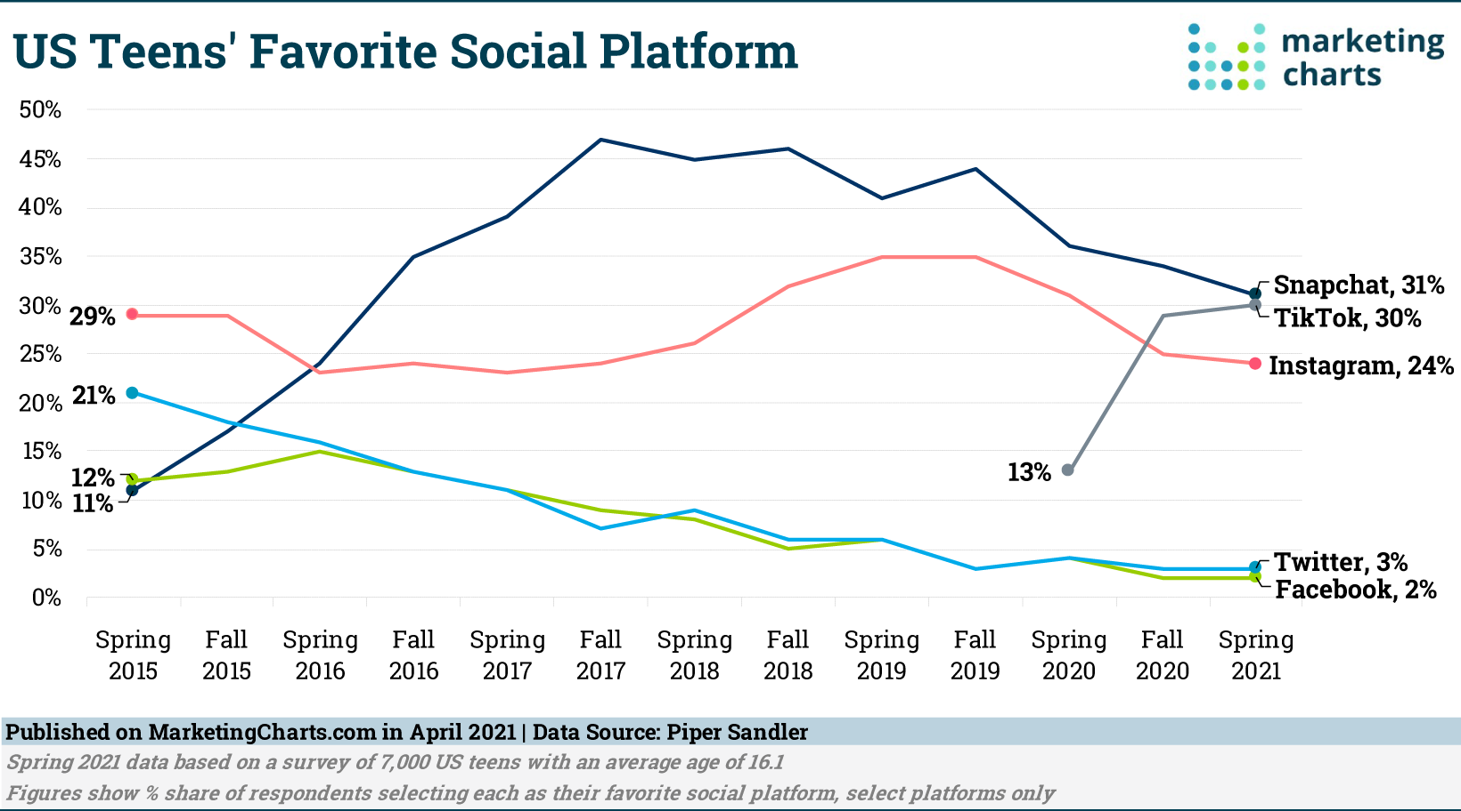
Prevalence of Social Media Use
Notes:
ROHAN LEAD
Rohan Mehta: Social media is a big part of many teens' lives. A 2018 Pew Research Center survey of nearly 750 13- to 17-year-olds found that 45% are online almost constantly and 97% use a social media platform, such as YouTube, Facebook, Instagram or Snapchat.
Craig Watkins:

Slide 10
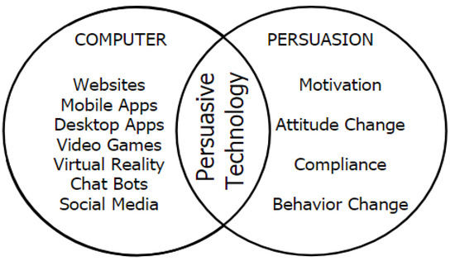
Understanding the Business Model
Ad revenue and engagement time
Persuasive Technology
Notes:
ROHAN LEAD
Social media companies have a business model requiring people to be engaged for them to be able to monetize on ads. Hence, they are competing for our attention, trying to get us to spend more time on them.
In order to increase engagement time, social media sites collect data to predict what type of content should be suggested. This is harmful because it increases time on sites which is bad for mental health. It is also bad because they use content that is harmful: the content is often emotionally charged, polarizing, sexual, violent, etc. which all causes mental health changes
“Persuasive Technology” is used by social media companies to increase ability to manipulate user behavior effectively.
Variable-ratio reinforcement schedule (positive intermittent reinforcement) used by “pull down to refresh” to form an unconscious habit of checking the app (just like a slot machine)
“Tagging photo” feature → sends a notification → people forced to open the app to see, so they spend more time on the app

Slide 11
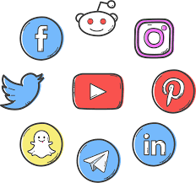
Tool or Something More?
vs.
Notes:
ROHAN LEAD
What is a tool? Ask audience to define
A tool genuinely sits there until you need to use it. Social media demands things from you, attempts to tempt or seduce or asks things from you. Concern about social media is not the same as being averse to new technology. Nobody said “society is ruined” when the car was invented, even though it caused changes to the world we knew.

Slide 12
Can you offer some personal examples of problematic social media use?
Notes:
ROHAN LEAD
Ask audience about if they feel their use of social media is problematic
Do you spend more time than you think on certain apps?
Do you have changes in attention span, productivity, irritability, impatience?

Slide 13
Problematic Uses of Social Media
& Technology
The Addiction Debate
Digital Pacifier
Time spent with social media
Is social media anti-social?
Notes:
Rohan:
“Tech addiction”: we have a basic biological imperative to connect with other people, millions of years of evolution have created a system that gives us dopamine hits from connecting to others. Hence, social media systems that optimize ease and degree of connectivity have the potential to be addictive.
Pleasure-pain balance, dopamine deficit states
We evolved to care about how our tribe feels about us bc it matters. We were not built to experience social approval from thousands of strangers, every 5 minutes
Huge increase in depression and anxiety in american teenagers beginning in 2010, and there is also a huge increase in self harm, suicide, eating disorders. This coincides with the availability of social media. Rate of driver license, romantic interaction/dates has dropped significantly due to reduced risk taking.
Manipulates attention, harder to pay attention to school/hw, unrealistic standards of beauty
Tech acts as a digital pacifier: prevents people from being able to process feelings of loneliness, discomfort, fear, sadness etc.
System that biases towards false info bc it increases engagement, but disinformation and extreme messages change people’s perceptions and beliefs
Tech will only get better at keeping our attention

Slide 14
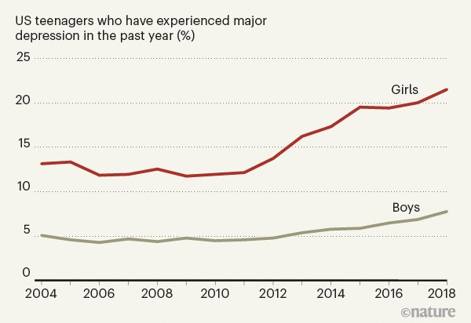
Mental Health Effects
Heightened risk of mental health issues
Depression
Anxiety
Sleep quality
Reported decline in life satisfaction
Belief that others are happier
Bullying, harassment or blackmail
Causation V. Correlation
Gender dynamics
Notes:
The risks might be related to how much social media teens use. A 2019 study of more than 6,500 12- to 15-year-olds in the U.S. found that those who spent more than three hours a day using social media might be at heightened risk for mental health problems. Another 2019 study of more than 12,000 13- to 16-year-olds in England found that using social media more than three times a day predicted poor mental health and well-being in teens.
Other studies also have observed links between high levels of social media use and depression or anxiety symptoms. A 2016 study of more than 450 teens found that greater social media use, nighttime social media use and emotional investment in social media — such as feeling upset when prevented from logging on — were each linked with worse sleep quality and higher levels of anxiety and depression.
How teens use social media also might determine its impact. A 2015 study found that social comparison and feedback seeking by teens using social media and cellphones was linked with depressive symptoms. In addition, a small 2013 study found that older adolescents who used social media passively, such as by just viewing others' photos, reported declines in life satisfaction. Those who used social media to interact with others or post their own content didn't experience these declines.
And an older study on the impact of social media on undergraduate college students showed that the longer they used Facebook, the stronger was their belief that others were happier than they were. But the more time the students spent going out with their friends, the less they felt this way.
Because of teens' impulsive natures, experts suggest that teens who post content on social media are at risk of sharing intimate photos or highly personal stories. This can result in teens being bullied, harassed or even blackmailed. Teens often create posts without considering these consequences or privacy concerns.

Slide 15
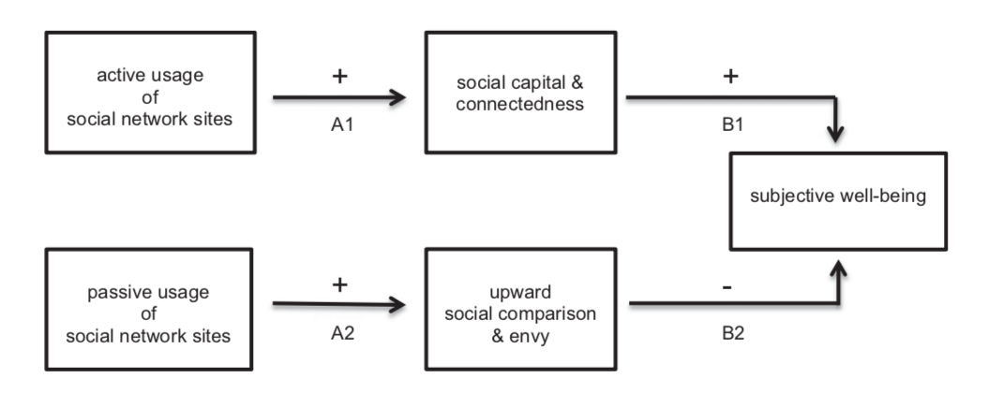
Social Media Behaviors and Subjective Well-Being

Slide 16
Positive Aspects of Social Media Use
Identity development
Communication, Social networks
Entertainment
Self-expression
Intellectual stimulation and access to information networks
Notes:
Dr. Watkins

Slide 17
What does digital wellness mean from your perspective?
Notes:
Dr. Watkins

Slide 18
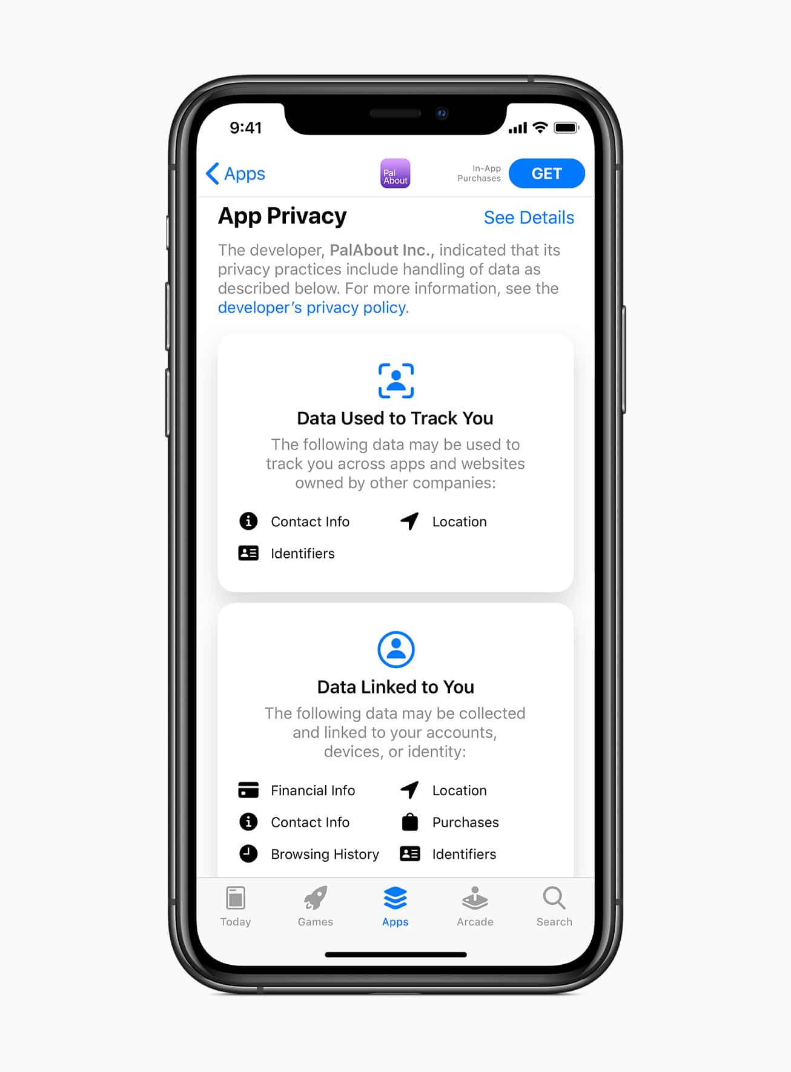
Digital Wellness
Technical Component
Human Behavioral Component
Behavioral Component
Notes:
Dr. Watkins

Slide 19
How should adults approach the topic of social media use with youth?
Notes:
Prompt the audience to speak

Slide 20
Approaching the Topic with Youth
“When I was a boy of fourteen, my father was so ignorant I could hardly stand to have the old man around. But when I got to be twenty-one, I was astonished at how much he had learned in seven years.”
- Mark Twain
Notes:
ROHAN LEAD
It’s hard for youth to just accept the advice of older people, and at times we tend to dismiss it. Older people didn’t grow up with technology so it seems sometimes that they are unnecessarily concerned about social media use. When I got older I realized my parents might have been correct. The manner of approaching the topic really matters to get youth to listen to your perspective. “coming across as good-intentioned and not condescending or out-of-touch with what adolescents want, while acknowledging the downsides as well as the positives of social media.”
Encourage self reflection, ask them to make reasonable goals about their screen time and usage and have them monitor themselves to follow it. Help them realize on their own that usage may be out of control. Talk about privacy settings and safety online, make these rules.

Slide 21
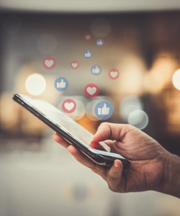
How should adults approach the topic of social media use
with youth?
Age/Maturation
Literacy
Communication
Agency

Slide 22
S. Craig Watkins
craig.watkins@austin.utexas.edu
Twitter: @scraigwatkins
Rohan Mehta
rohanmehta@utexas.edu

